Slide 1

US Coffee Imports:
How Exporters Compete for
Market Share

Slide 2
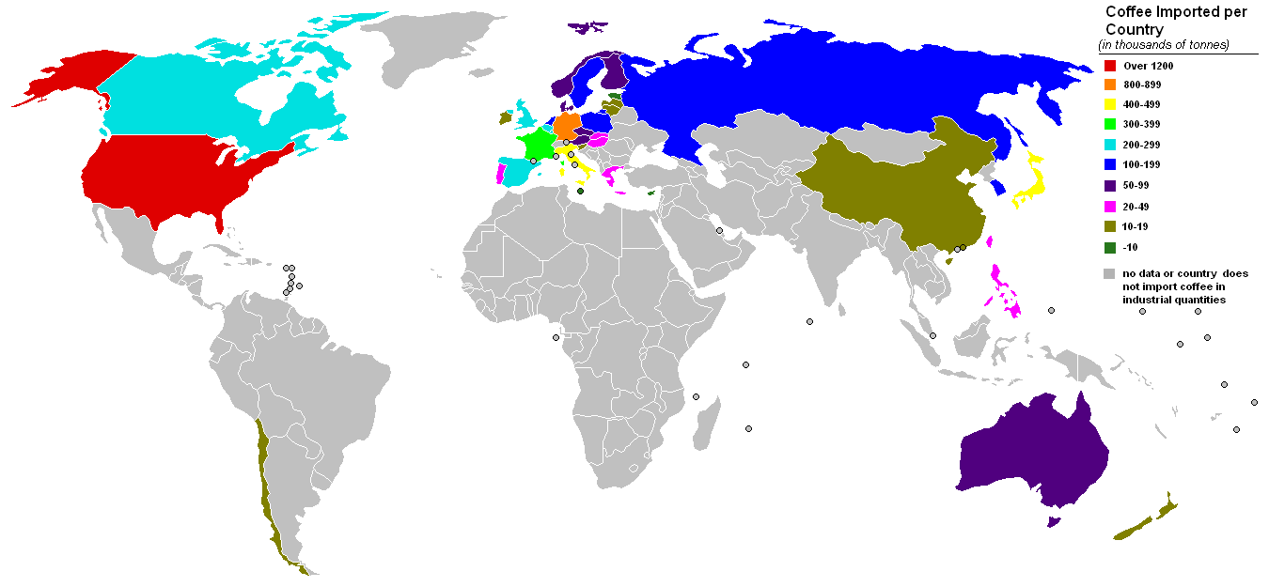
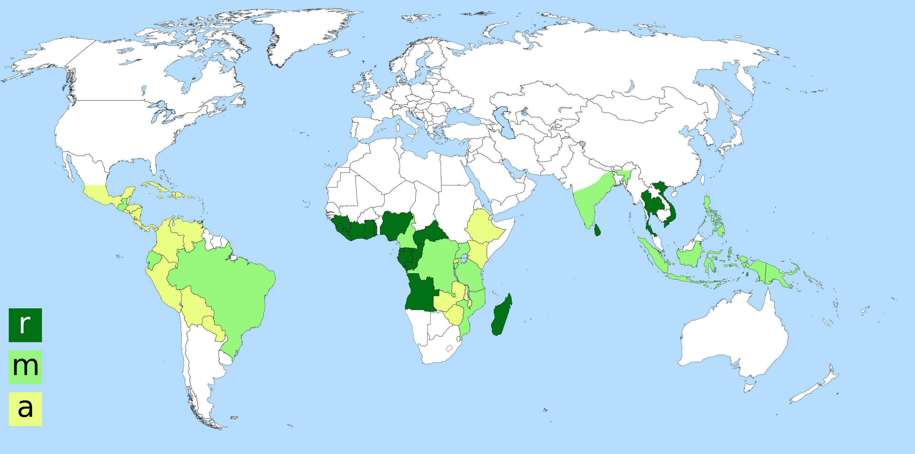

Slide 3
FACTS:
United States does not produce coffee beans.
Over 1.5 billion kilograms of coffee was imported in 2014.
Coffee: price-sensitive and prone to supply fluctuations
(esp. based on weather changes)
Coffee is mostly produced by smallholder farmers in developing countries. They compete for market share in the largest coffee market in the world. Decision maker = US coffee buyers
US buyers and consumers care about sustainability of coffee production – environmental & social.
RESEARCH QUESTION:
How does the economics and mechanism of the global coffee markets affect the market share of coffee-exporting countries in the U.S. market? How does an exporting country maximize their market share?

Slide 4

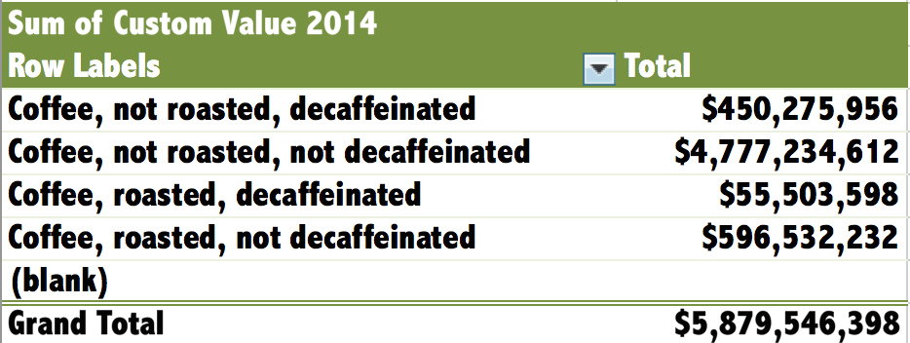
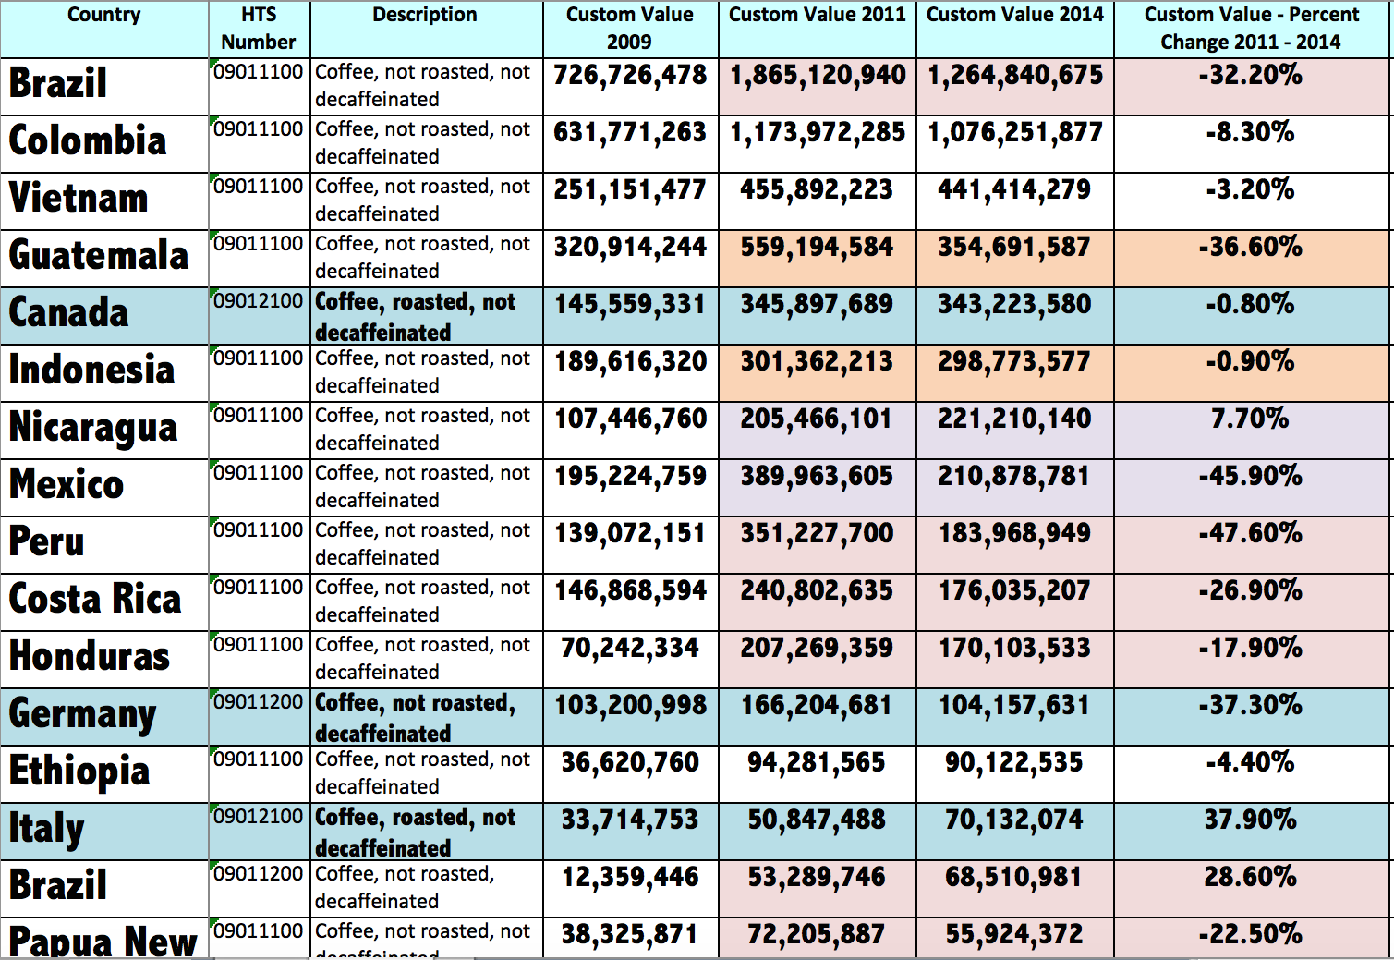
US import data (2009, 2011, 2014)
http://dataweb.usitc.gov/

Slide 5
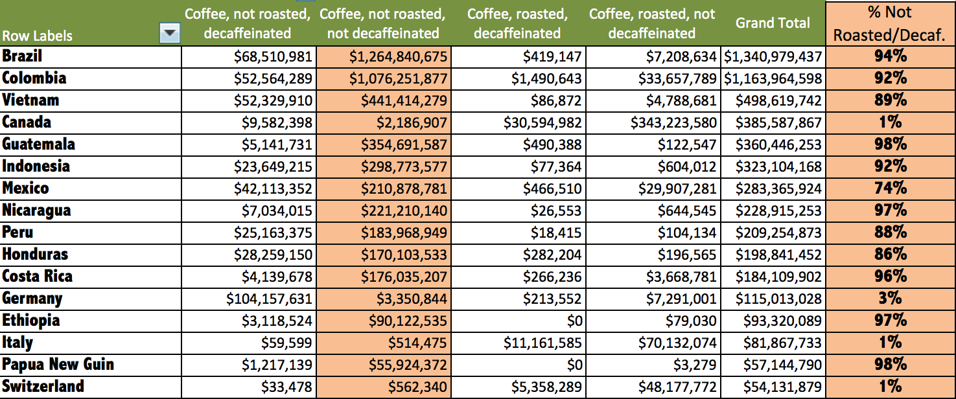
US import data (2009, 2011, 2014)
HTS Number | 2014
09011100 Coffee, not roasted, not decaffeinated | $4,777,234,612
09012100 Coffee, roasted, not decaffeinated | $596,532,232
09041100 Pepper of the genus Piper, neither crushed nor ground | $451,967,260
09011200 Coffee, not roasted, decaffeinated | $450,275,956

Slide 6
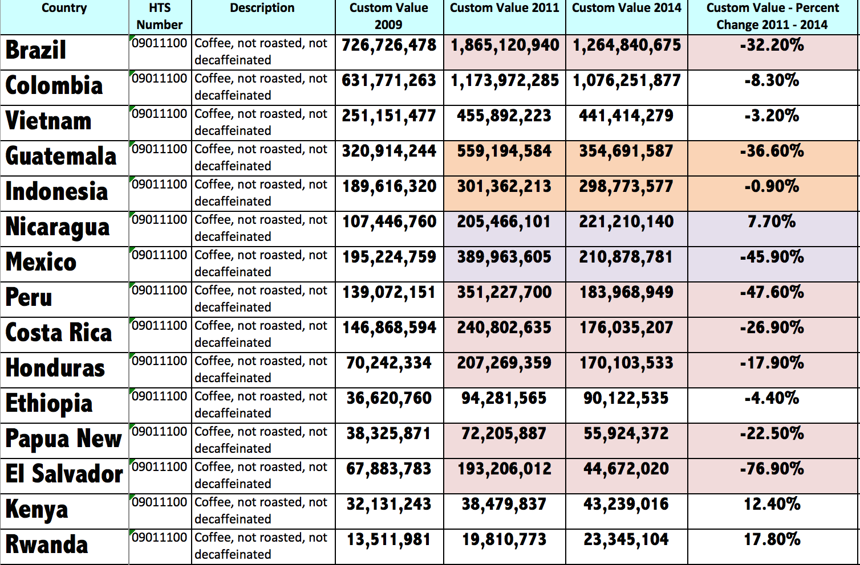
US import data (2009, 2011, 2014) – not roasted or decaffeinated

Slide 7
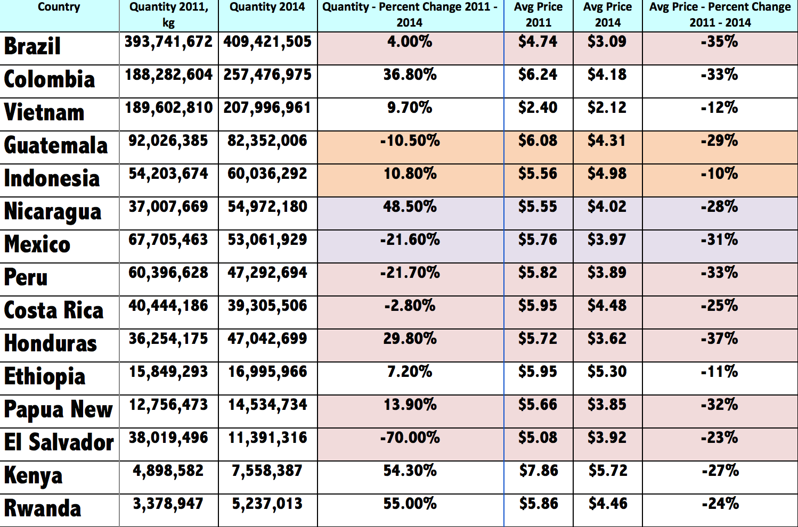
US import data (2011, 2014) – Quantity & Avg Price/kg

Slide 8
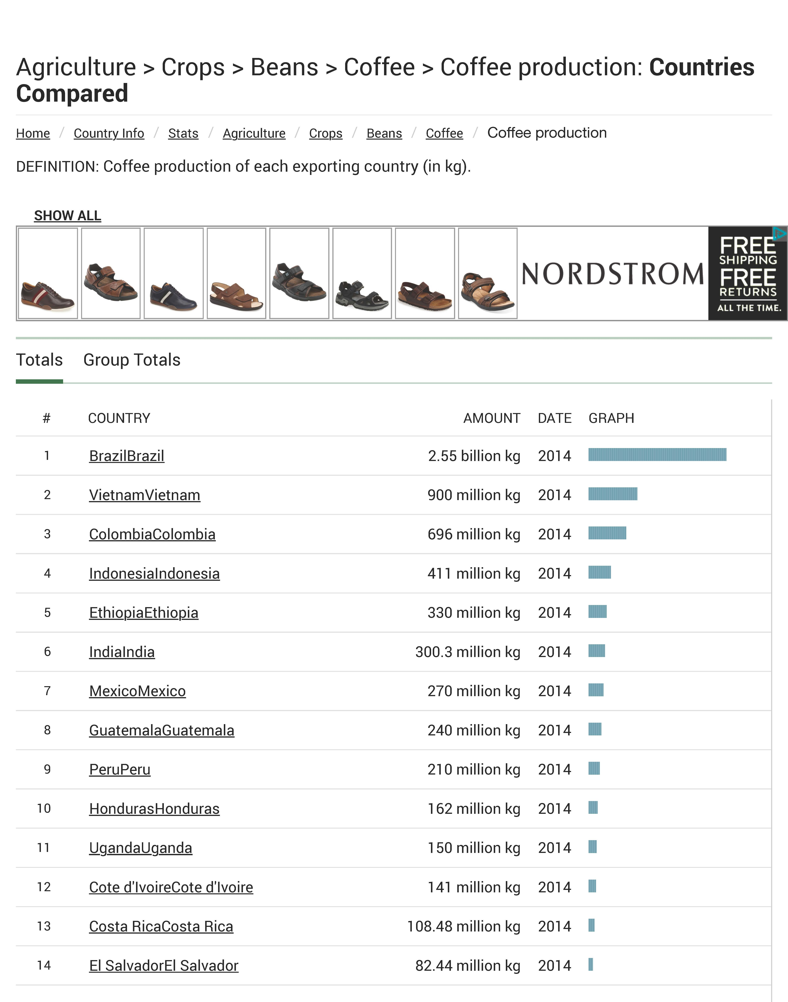

Slide 9
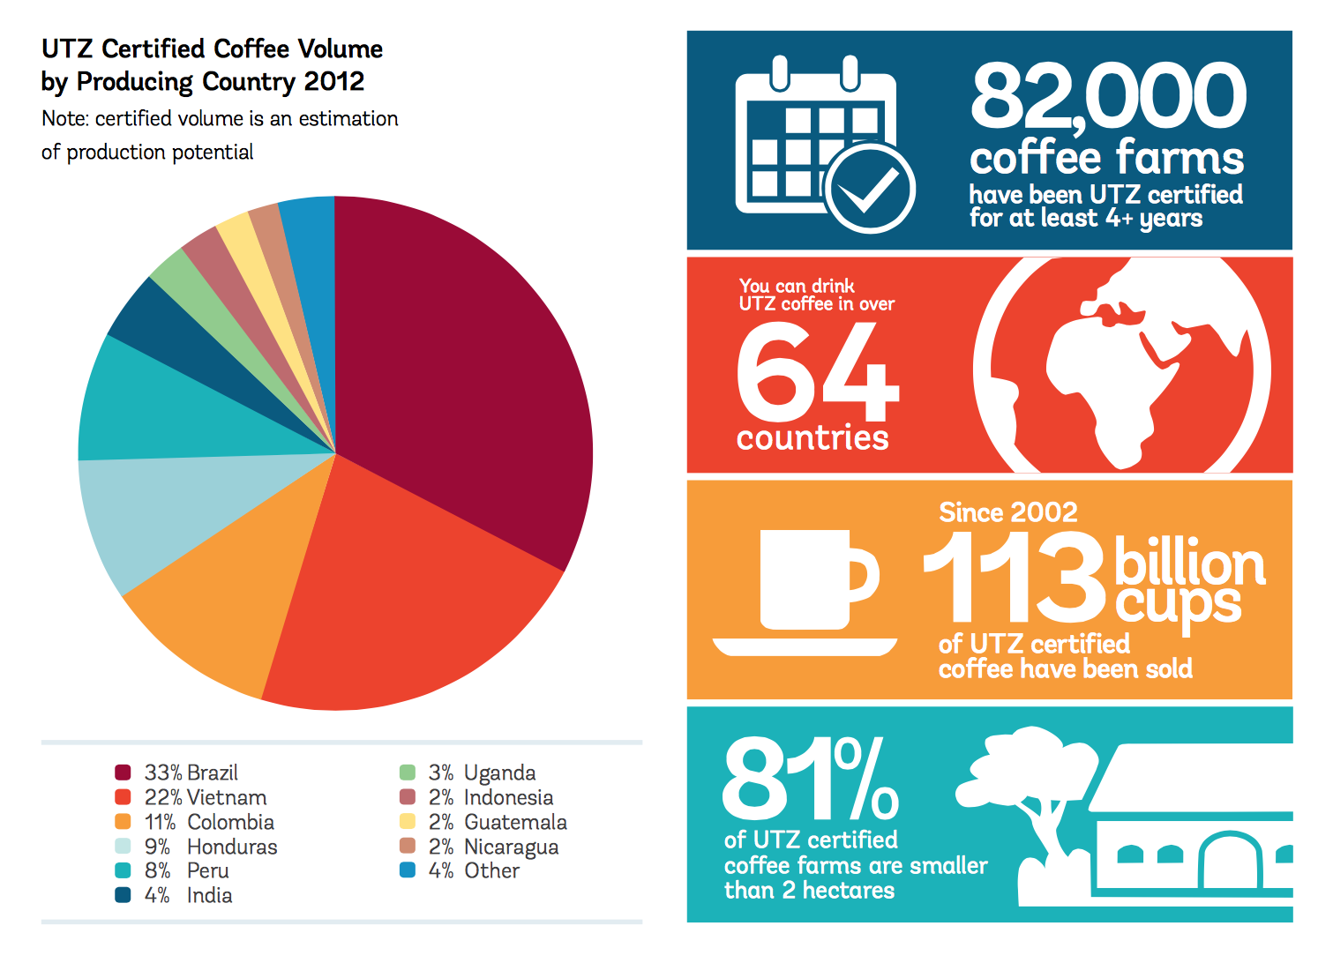

Appropriate and modest use of fertilizers, pesticides, water and energy
Children of coffee farmers sent to school rather than put to work.
Farm workers given decent labor rights, housing and healthcare, and empowered to act as professionals and become better businessmen.

Slide 10
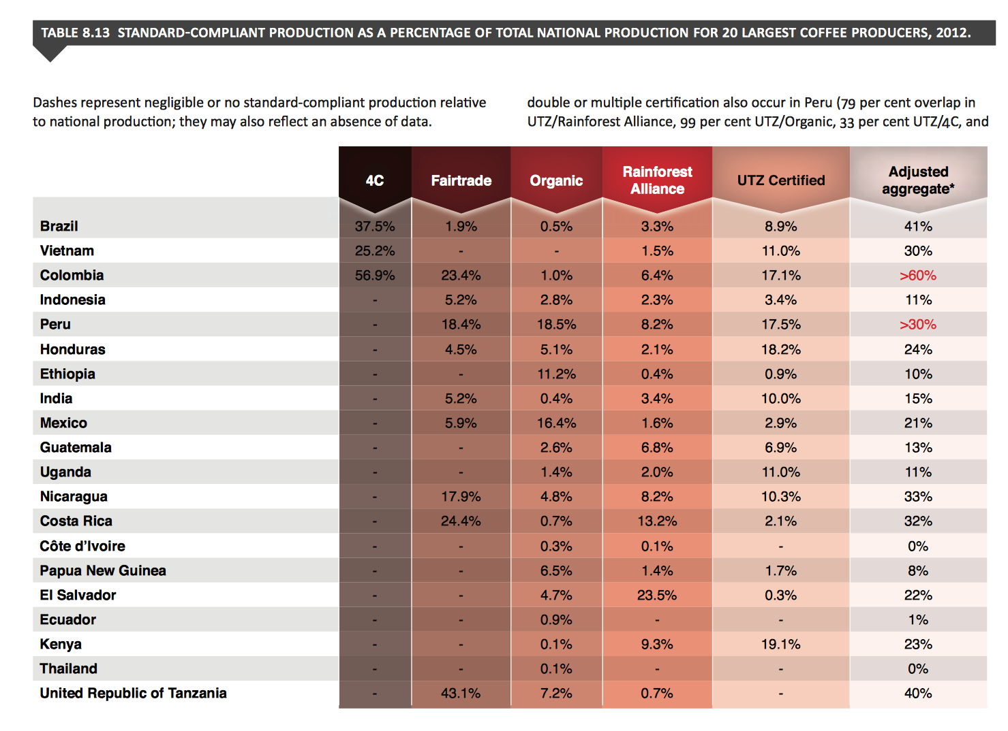





Slide 11
MODEL
FEATURES:
average price per kg (2014)
percent change in average price per kg (2011-2014)
percent change in quantity of exports (2011-2014)
total production in kg (2014)
percent ‘certified’ coffee of national production (2012)
RESPONSE:
Market share of US coffee (not roasted or decaf) imports - 2014

